Slide 1

EPIC
EXTRASOLAR Planetary Imaging coronagraph
Freddie Romano

Slide 2
The Purpose of EPIC
How EPIC Works
Discovery and analysis of exoplanets
Specifically those that might support carbon based life forms
Detection through coronagraphy
Block out starlight
Planet light is then detected and can be analyzed
Notes:
Put goals here

Slide 3
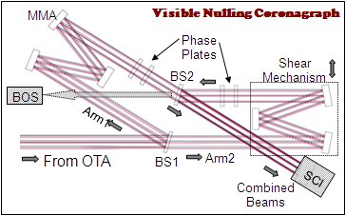
VNC – Visible Nulling Coronagraph
Coronagraphy through interferometry
Light is passed to Mach-Zehnder interferometer
Beam is split into two arms
One arm receives a phase shift

Slide 4
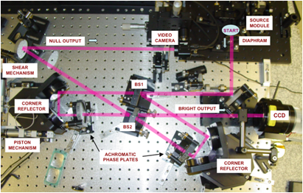
VNC
Two cameras receive ‘output’
Without phase shift, each ~equal
In ideal conditions, one null, one bright
Applies to the more coherent starlight, not the planet light

Slide 5
Effect of Sound and Vibrations
Vibrations can cause errors in nulling
Mirror positions must be correct to less than a wavelength
Even very little movement can cancel the null
Vibrations can be countered with a deformable mirror

Slide 6
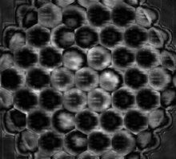
The Deformable Mirror (DM)
Can vary in size
Broken up into segments
Each segment can move on its own in piston/tip/tilt
Each actuator moves its segment by the application of a voltage

Slide 7
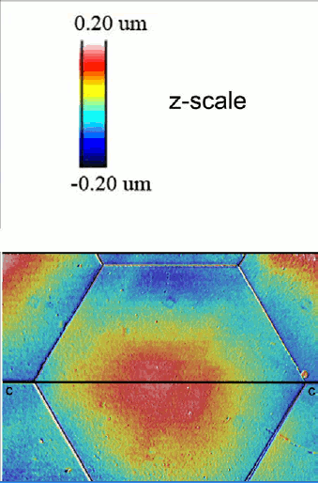
How a DM Can Negate Vibration Effects
A computer connected to both a camera and a DM can move the segments of the DM to the darkest point
By quickly updating mirror positions, the computer can keep the entire mirror at the darkest fringe

Slide 8
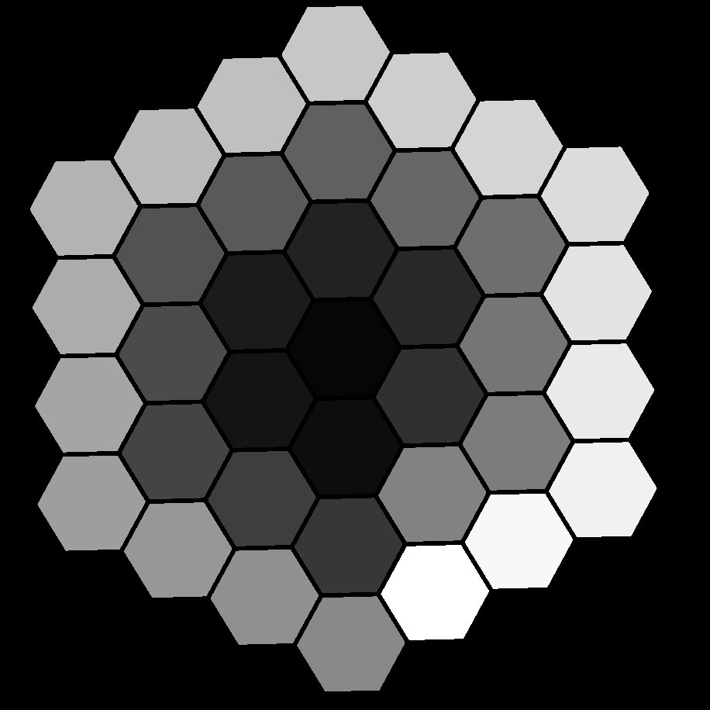
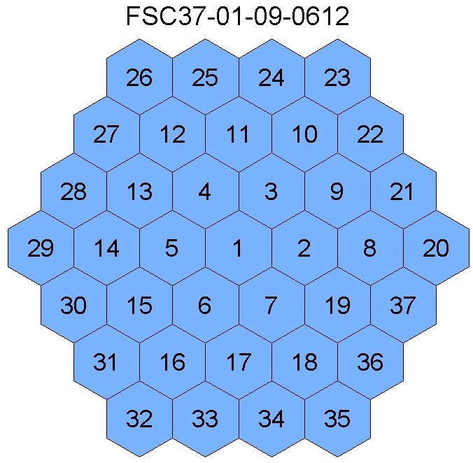
The Digital Mask
To know which segment is which, computer uses mask
Digital map with numbered pixels that correspond to the numbered segments
Knows which segment to move by comparing camera image to ‘mask’

Slide 9
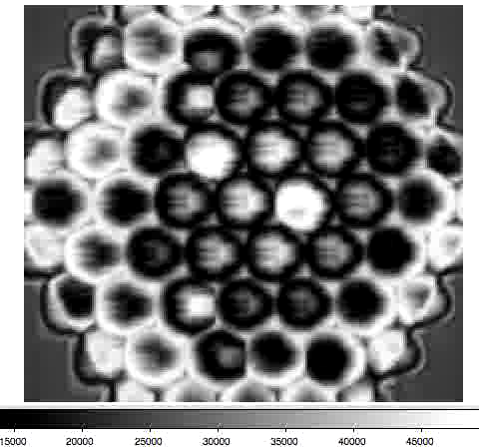
Steepest Descent Algorithm
Automates process of positioning the DM to create a null
Reads data from camera and positions segments to become as dark as possible
Trial and Error

Slide 10
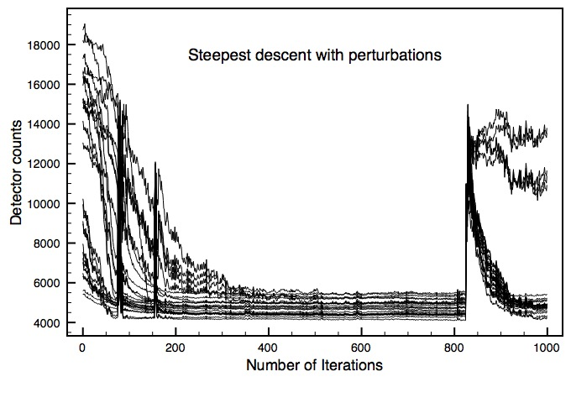
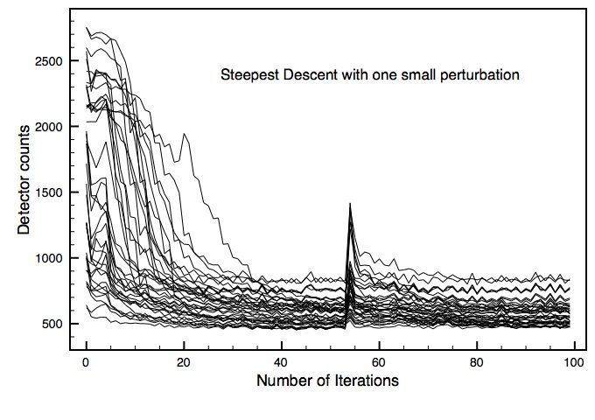
Boston Micromachines
IrisAO

Slide 11
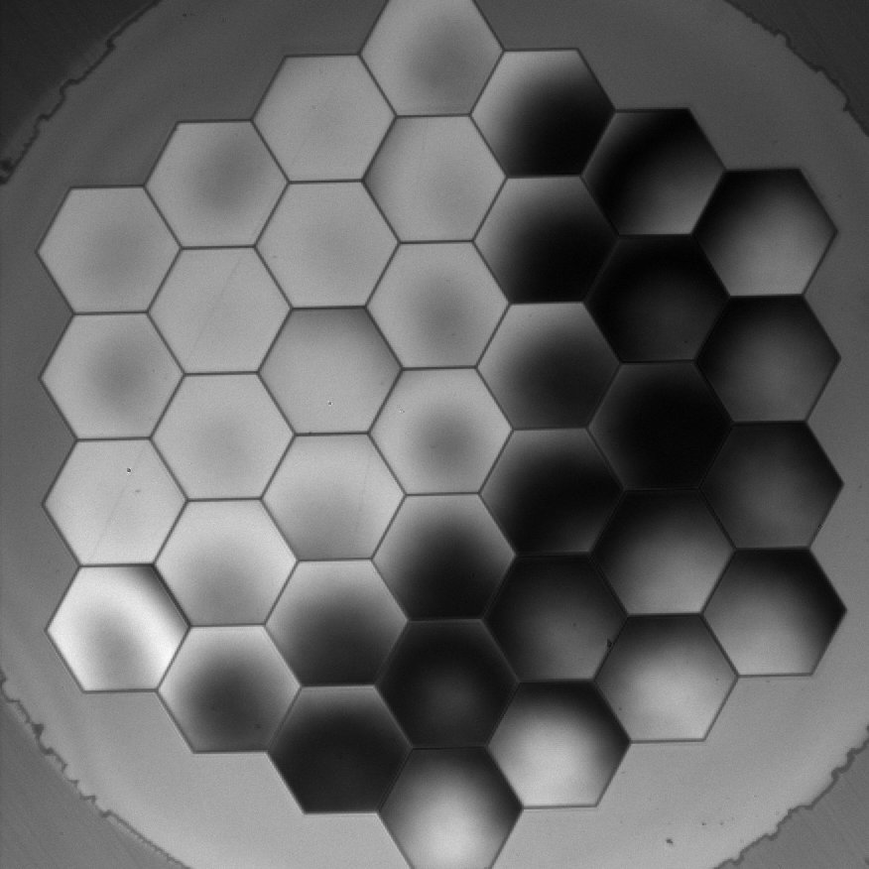
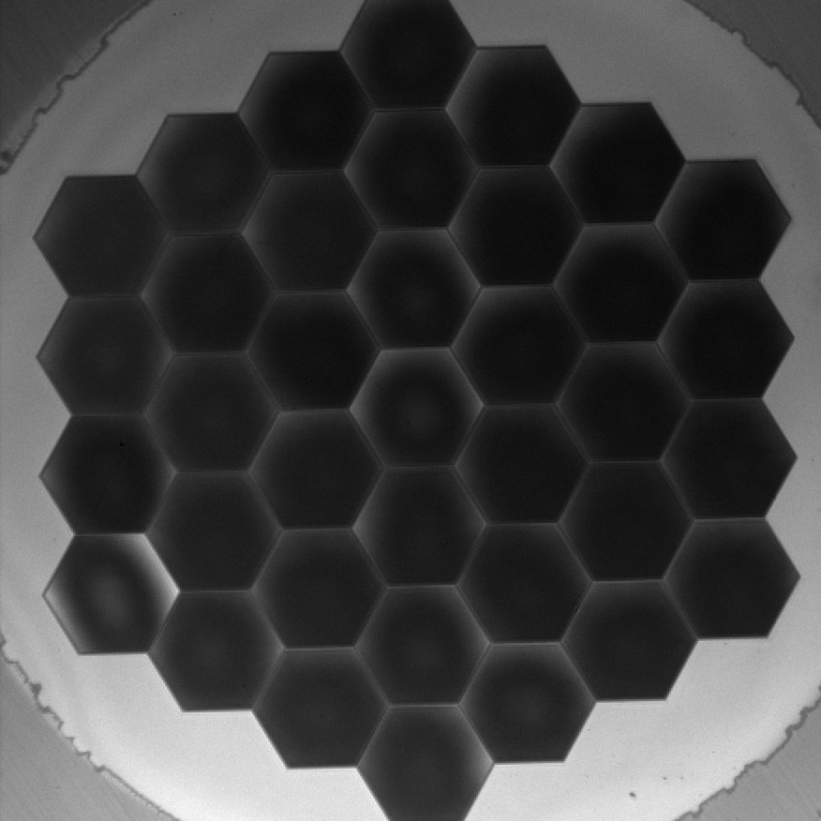
IrisAO S37-X DM

Slide 12
End

Slide 14
Some things I have specifically worked on:
Set up masks to block light from faulty segments
Set up the new IrisAO DM and ran the first tests
Combined the mask generating programs into a more efficient process

